Slide 1


Simulated clinical trials and endpoints
Saumil Shah Postdoc Simulation CDS (10499)

Slide 2





Overview
Aim
Background
Simulation study
Possible extensions
cell-cycle explicit agent-based model
simulated clinical endpoints
performance of immunotherapy
summary

Slide 3
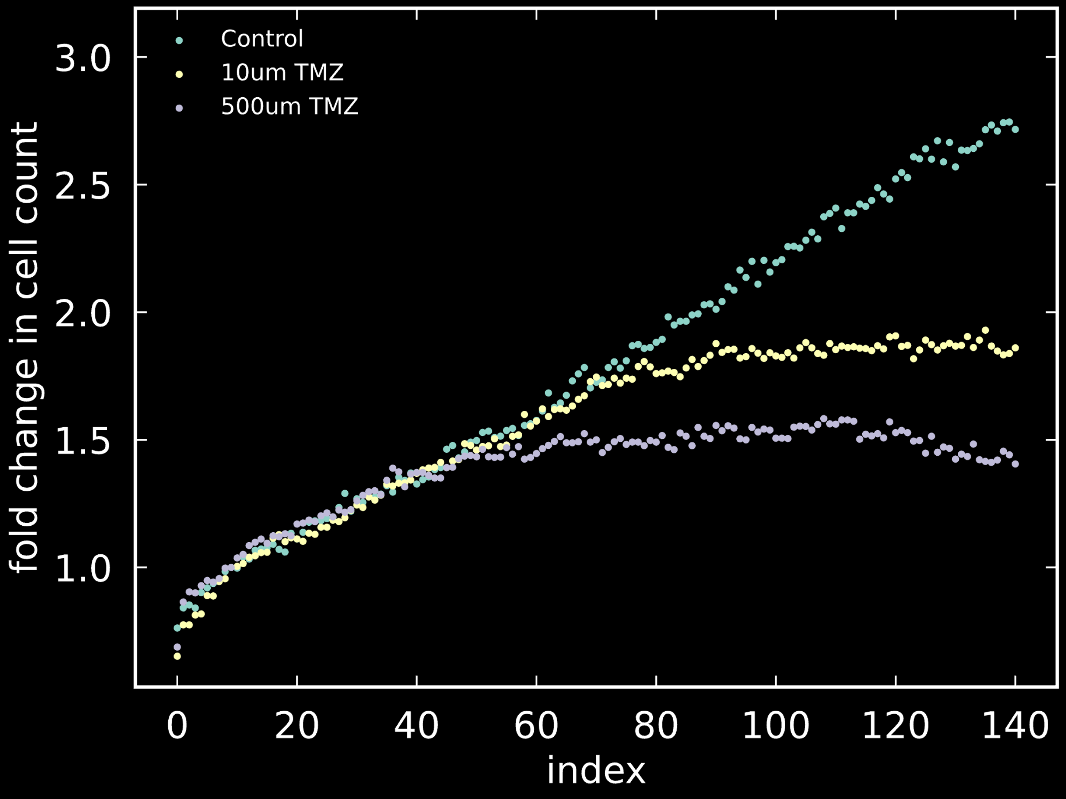

Delayed treatment response of glioblastoma cell lines
+
Control
GBM
cell lines
Temozolomide
Notes:
Glioblastoma is a cancer of brain cells.
Temozolomide is the only chemotherapeutic drug for glioblastoma.
In many cases tumors show a rather quick enzyme mediated resistance response against it.

Slide 4




Cell-cycle explicit simulations
stage-specific
treatment
Me
Me
enzyme-driven
demethylation
cell-cycle
arrest
Me
methylated
cell cycle
progression
cell division

Slide 5
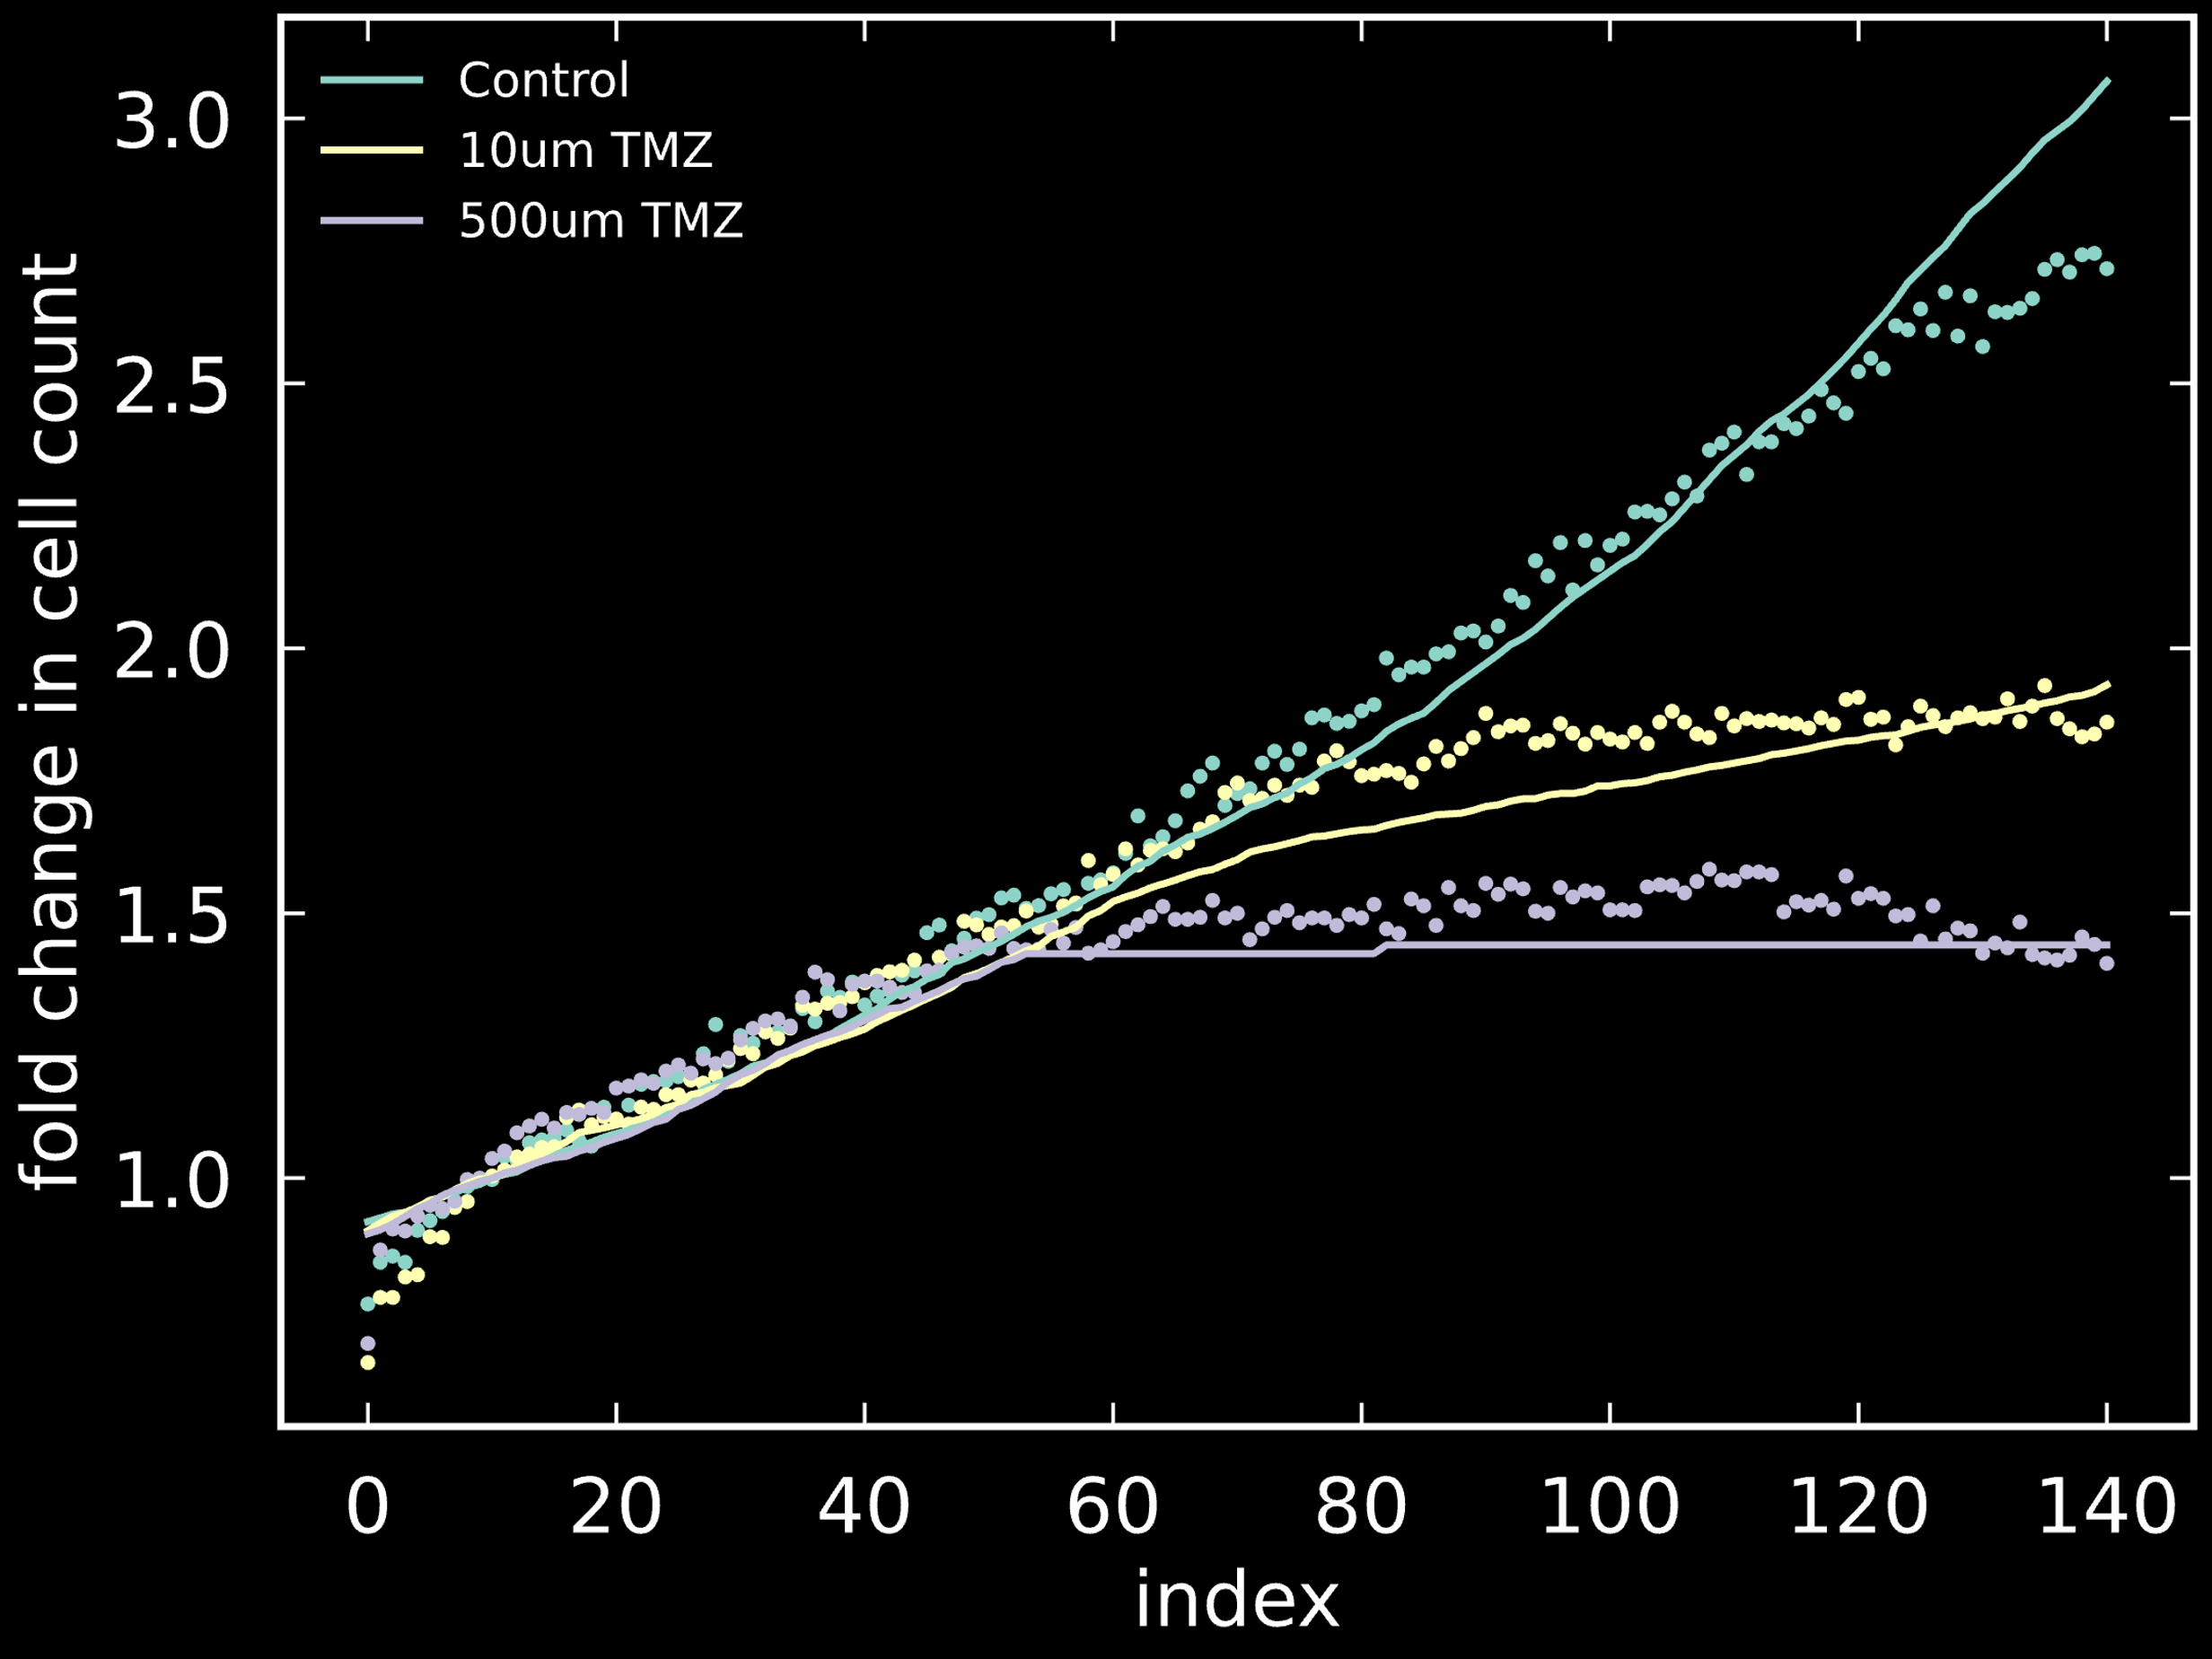
Delayed treatment response of glioblastoma cell lines
(preprint came out yesterday)
Control
Notes:
Glioblastoma is a cancer of brain cells.
Temozolomide is the only chemotherapeutic drug for glioblastoma.
In many cases tumors show a rather quick enzyme mediated resistance response against it.

Slide 6











What are cellular therapies?
$1.$ Isolation
$2.$Modify
$3.$Infuse

Slide 7

Possible assumptions
unrestricted
unrestricted
effector interference
handling time
Effector activation
effector
density
tumor defense
tumor
density
relative abundance

Slide 8






Bayesian model selection
from
experiments
Model $1$
distance
Model $5$
.
.
.
Model $6$
Model $6$
Model $3$
Model $2$

Slide 9



CAR T cell performance and effector to target ratio
regular T cell
vs.
CD$371$ CAR T cell
$$\log{ target killing rate \left({day}^{−1}\right)}$$
$$\log{ effector death rate \left({day}^{−1}\right)}$$
Model: ratio-dependent activation

Slide 10
Aim
Simulate primary clinical endpoint based on a clinical trial
Estimate the sample size for the clinical trial
Test two different hazard models

Slide 11

Implementation
R programming language
survival package “ecosystem”
code is available on Github

Slide 12
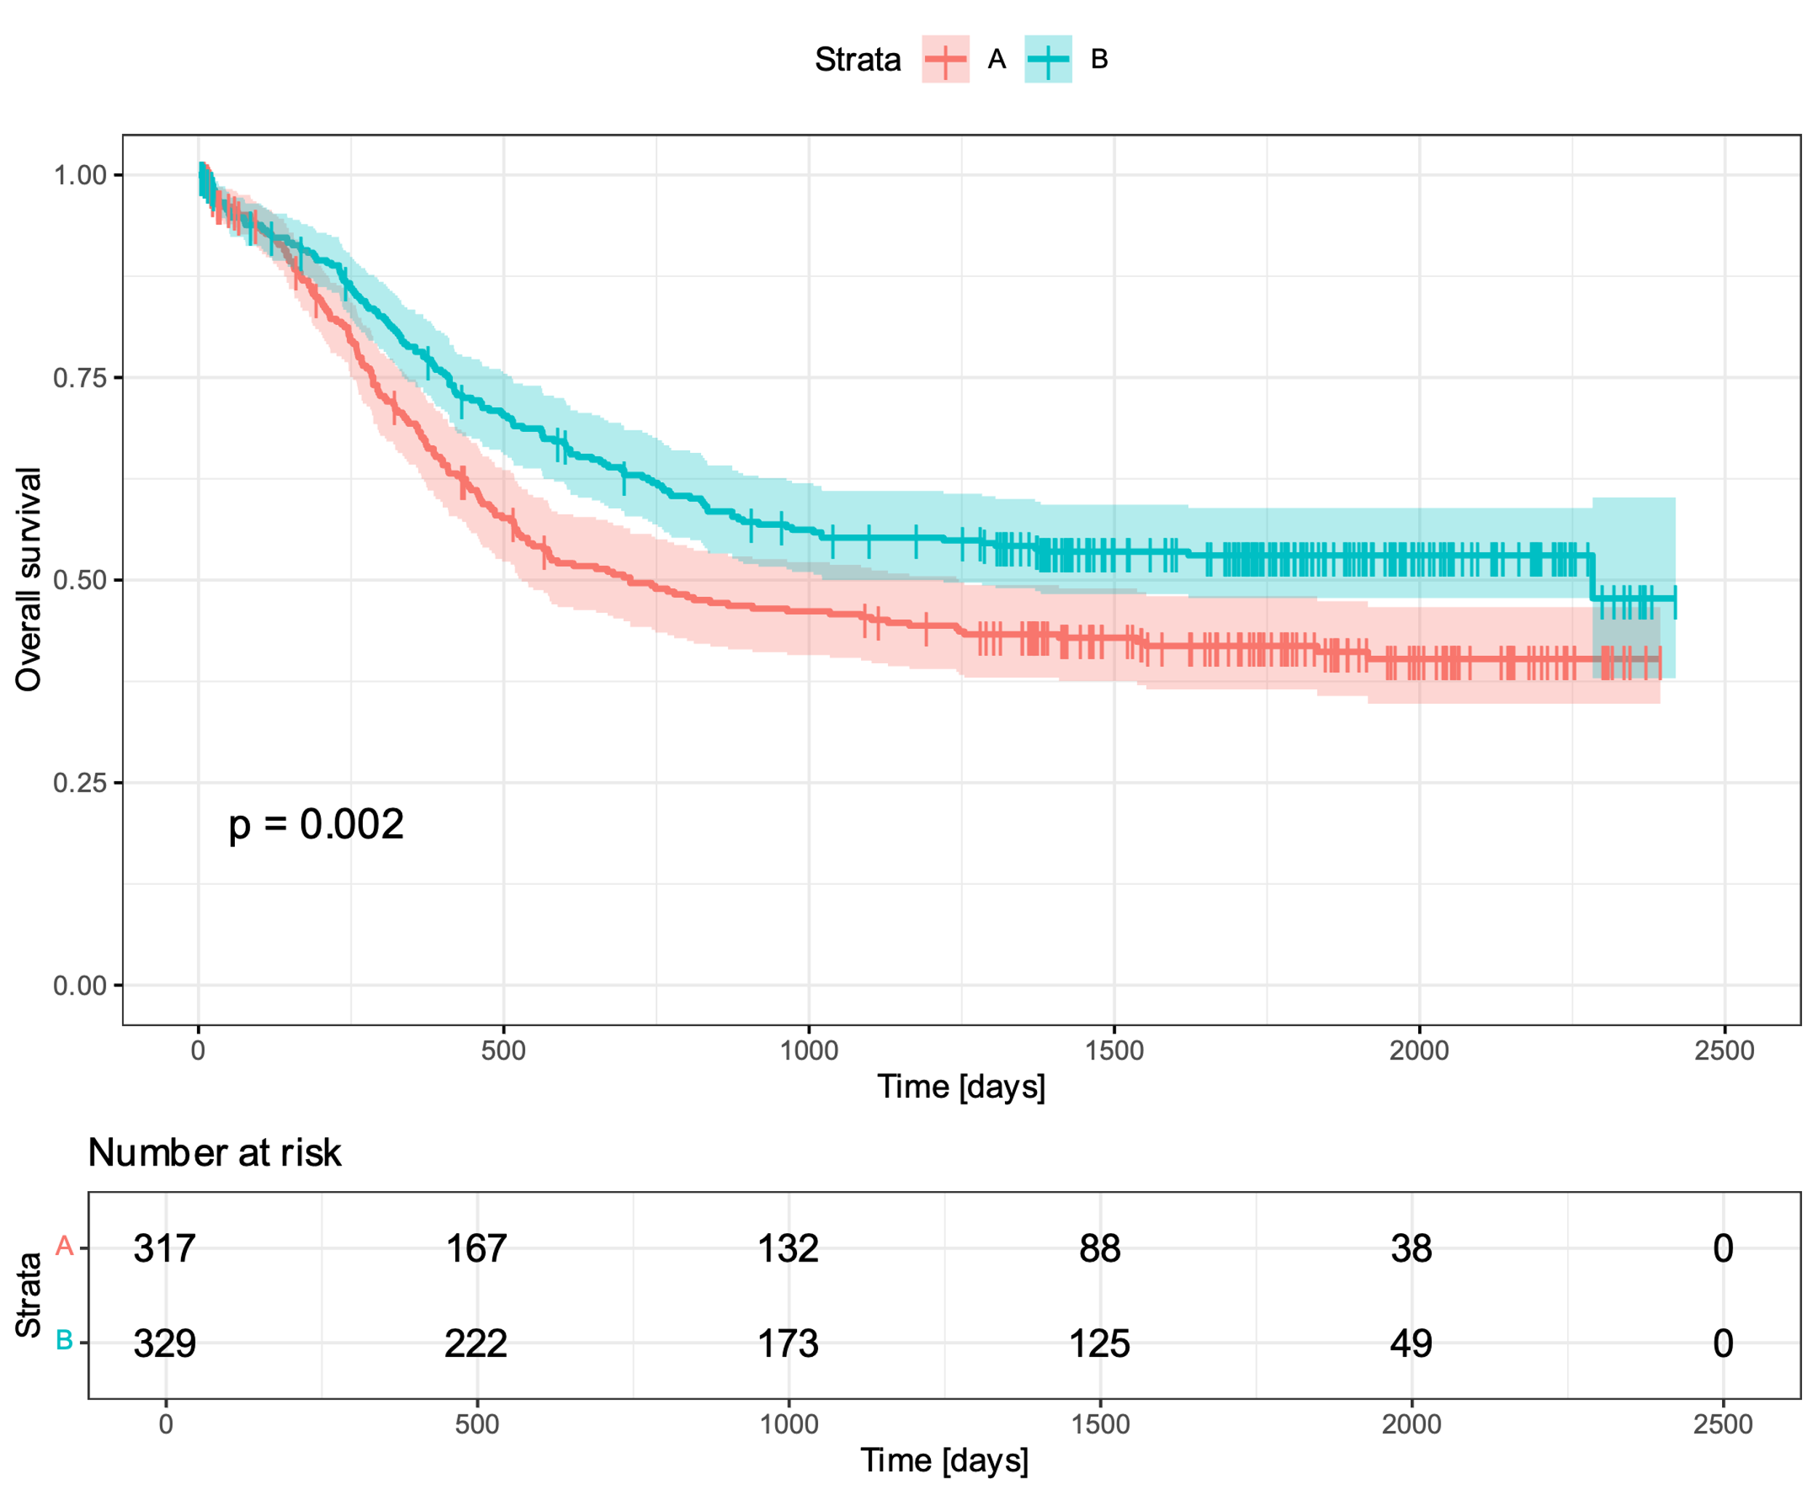
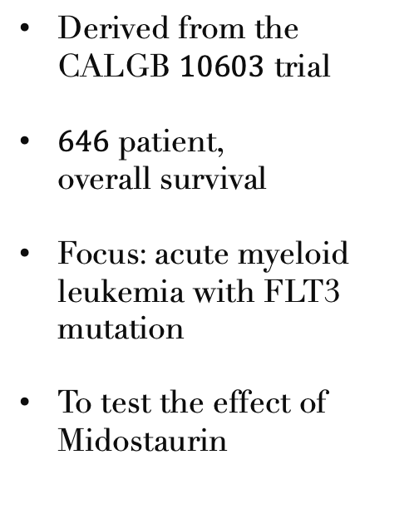
Background
Derived from the CALGB $10603$ trial
$646$ patient, overall survival
Focus: acute myeloid leukemia with FLT3 mutation
To test the effect of Midostaurin

Slide 13
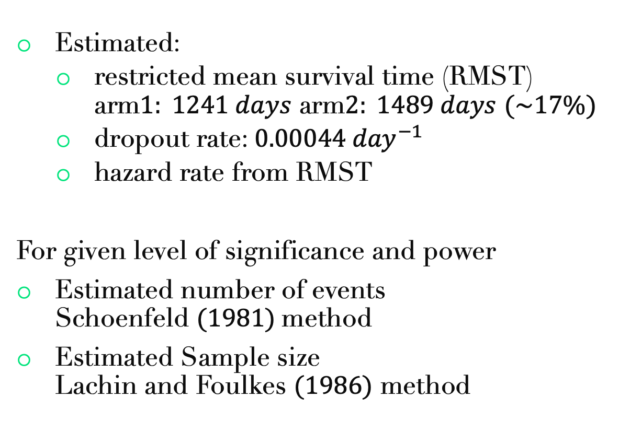
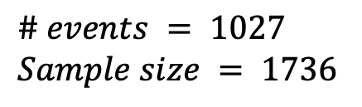
Sample size estimation
Estimated:
restricted mean survival time (RMST) arm$1: 1241 days$ arm$2: 1489 days$ $(\sim 17\%)$
dropout rate: $0.00044 {day}^{−1}$
hazard rate from RMST
For given level of significance and power
Estimated number of events Schoenfeld $(1981)$method
Estimated Sample size Lachin and Foulkes $(1986)$ method
$$\# events = 1027$$
$$Sample size = 1736$$

Slide 14
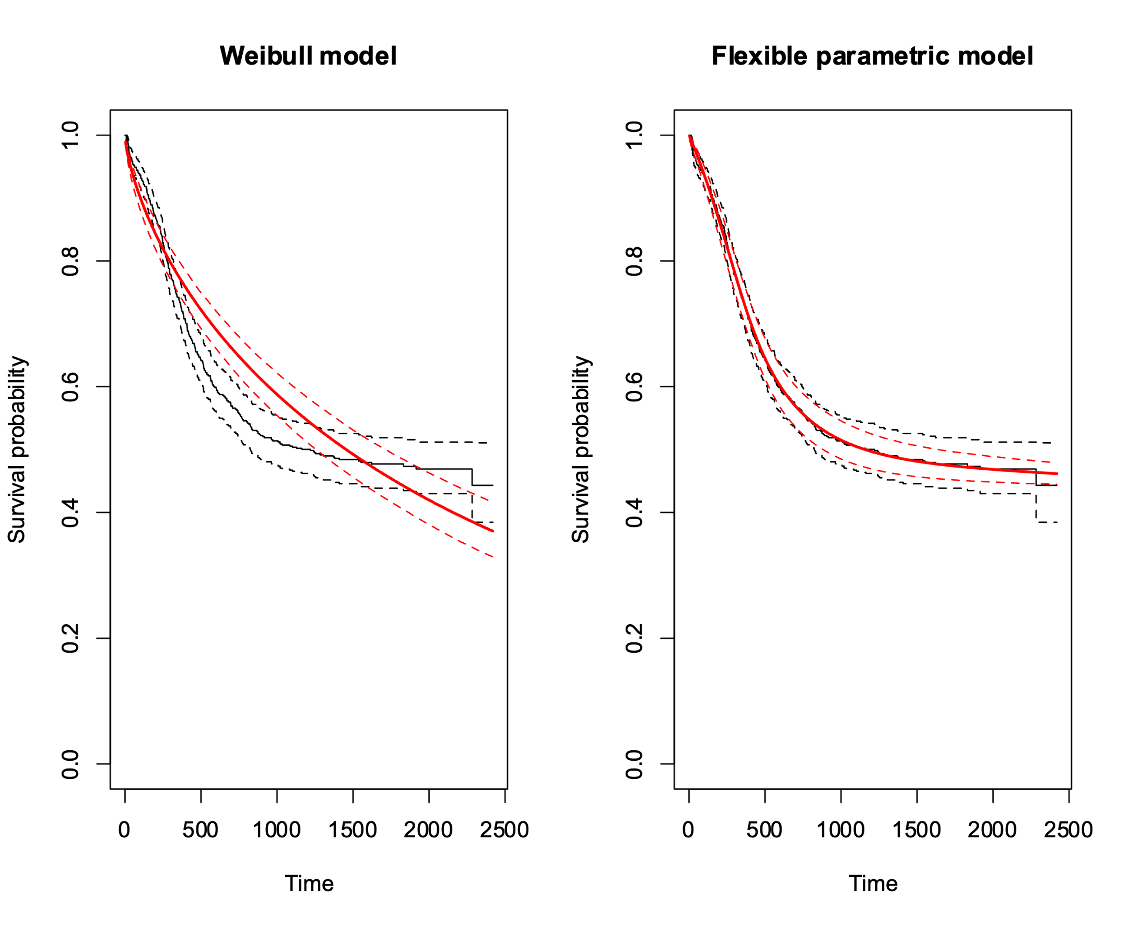
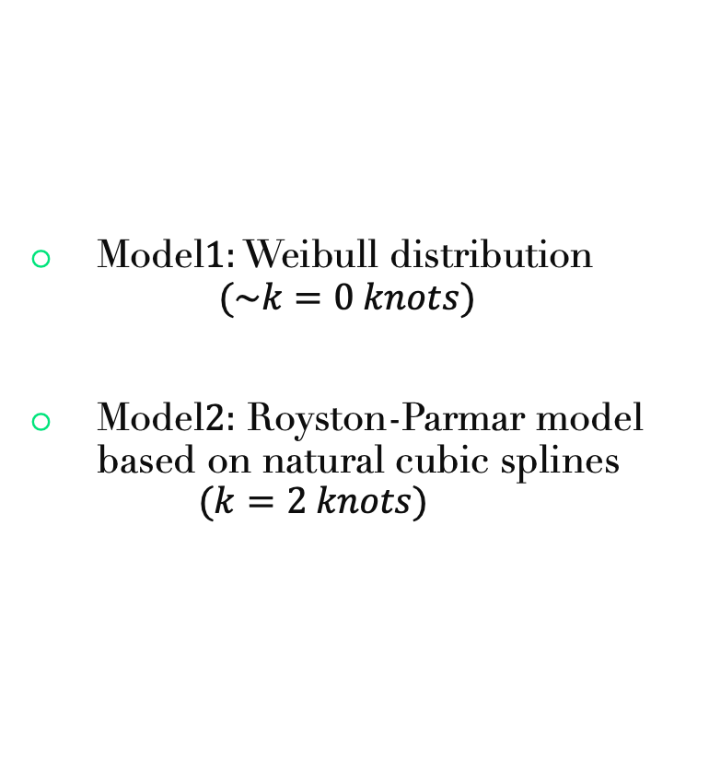
Two hazard models
Model$1:$ Weibull distribution $(\sim k=0 knots)$
Model$2:$ Royston-Parmar model based on natural cubic splines $(k=2 knots)$

Slide 15
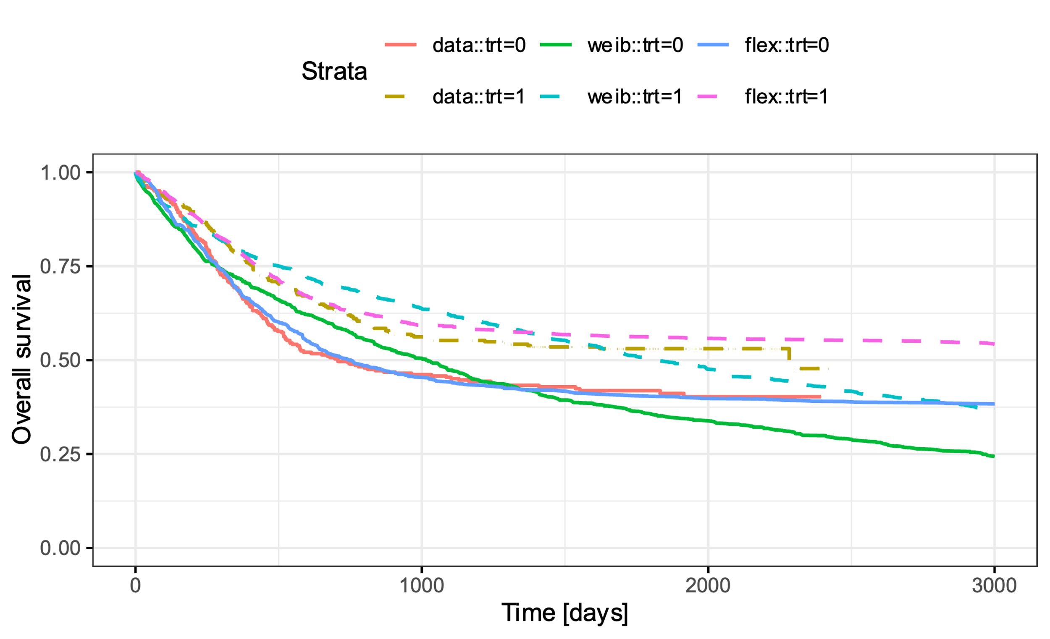
Simulated overall survival

Slide 16
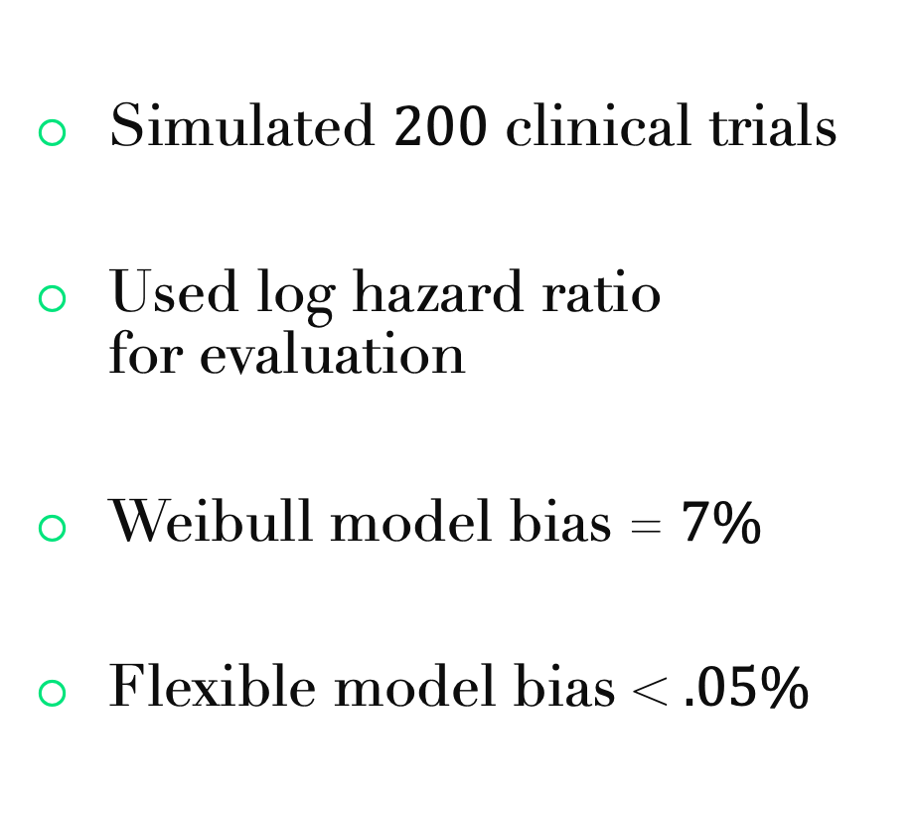
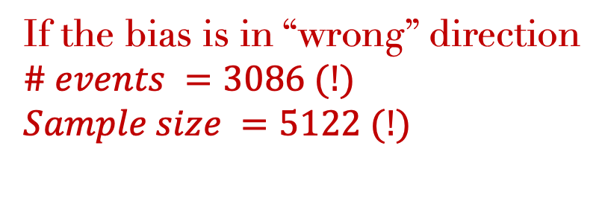
Comparison
Simulated $200$ clinical trials
Used log hazard ratio for evaluation
Weibull model bias = $7\%$
Flexible model bias < $.05\%$
If the bias is in “wrong” direction
$$\# events =3086 (!)$$
$$Sample size =5122 (!)$$

Slide 17
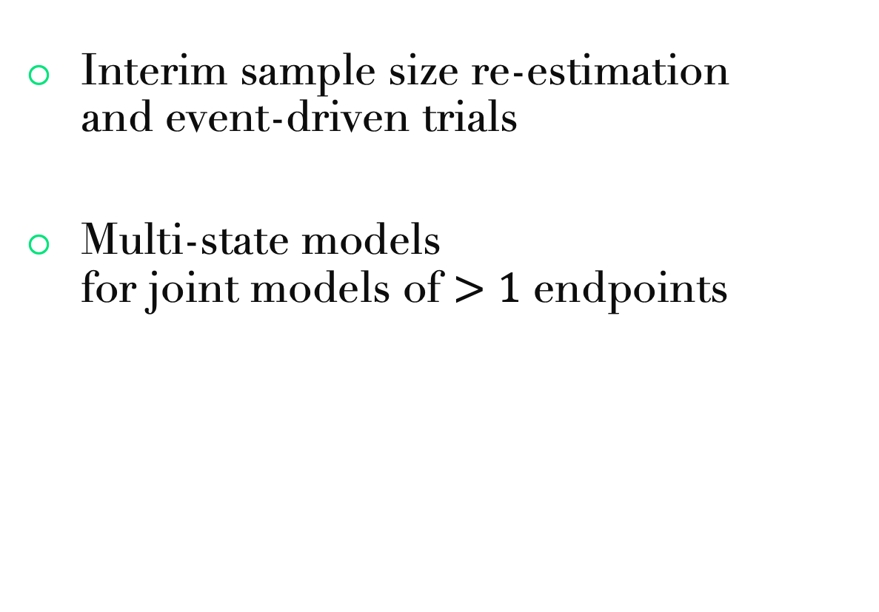
Possible extensions
Interim sample size re-estimation and event-driven trials
Multi-state models for joint models of $>1$ endpoints
progression
progression-free
death

Slide 18
Summary
Based on real-world leukemia dataset
Estimated sample size for clinical trials given level of significance and power
Compared two hazard models and the impact on sample size

Slide 19
Thank you!
Postdoc Simulation CDS (10499)

Slide 20
References
Le-Rademacher JG, Peterson RA, Therneau TM, Sanford BL, Stone RM, Mandrekar SJ. Application of multi-state models in cancer clinical trials. Clin Trials. 2018 Oct; 15 (5):489-498.
Schoenfeld D (1981), The Asymptotic Properties of Nonparametric Tests for Comparing Survival Distributions. Biometrika, 68, 316-319.
Lachin JM and Foulkes MA (1986), Evaluation of Sample Size and Power for Analyses of Survival with Allowance for Nonuniform Patient Entry, Losses to Follow-Up, Noncompliance, and Stratification. Biometrics, 42, 507-519.
Royston, P., & Parmar, M. K. (2002). Flexible parametric proportional‐hazards and proportional‐odds models for censored survival data, with application to prognostic modelling and estimation of treatment effects. Statistics in medicine, 21(15), 2175-2197.
Therneau, T. M. (2020). A Package for Survival Analysis in R. https://CRAN.R-project.org/package=survival

